Slide 1
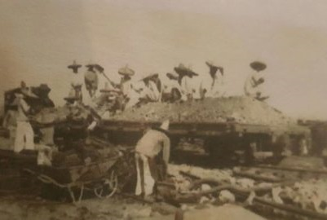

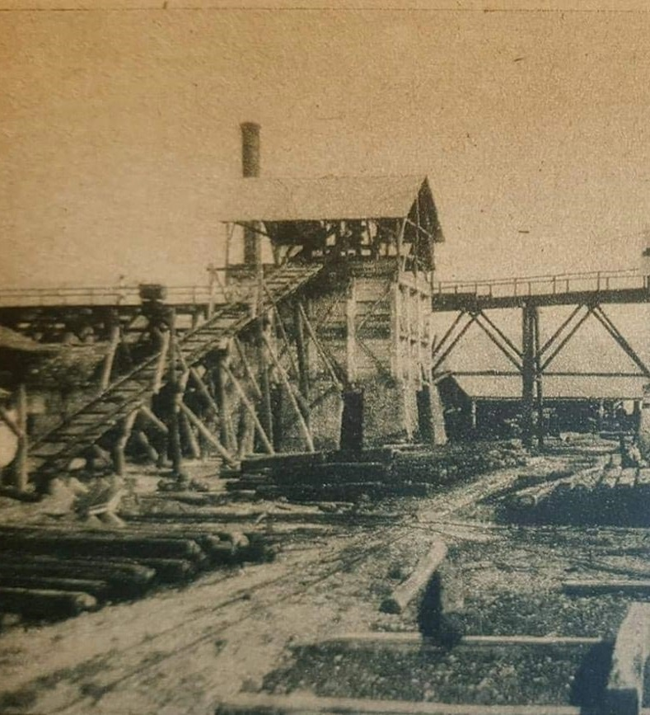
ADVANCING THE
SAN MARCIAL PROJECT
exploration upside AND
development options
ROSARIO MINING DISTRICT, SINALOA, MEXICO
MARCH 2019
TSX-V: GPLY FRANKFURT: GPE OTCQB: GLYXF
Change these two photos
I want to keep the standard
Old rosario mine in at least one
photo

Slide 2
CAUTIONARY STATEMENT
Certain information included in this document contains forward-looking statements. These forward-looking statements include, among others, statements with respect to the Company’s objectives, goals and strategies to achieve those objectives and goals, as well as statements with respect to the Company’s beliefs, plans, objectives, expectations, anticipations, estimates and intentions.
The words “may”, “will”, “could”, “should”, “would”, “suspect”, “outlook”, “believe”, “plan”, “anticipate”, “estimate”, “expect”, “intend”, “forecast”, “objective” and “continue” (or the negative thereof), and words and expressions of similar import, are intended to identify forward-looking statements.
By their very nature, forward-looking statements involve inherent risks and uncertainties, both general and specific, which give rise to the possibility that predictions, forecasts, projections and other forward-looking statements will not be achieved. Certain material factors or assumptions are applied in making forward-looking statements and actual results may differ materially from those expressed or implied in such statements. The Company cautions readers not to place undue reliance on these statements, as a number of important factors, many of which are beyond the Company’s control, could cause actual results may differ materially from the beliefs, plans, objectives, expectations, anticipations, estimates and intentions expressed in such forward-looking statements. These factors include, but are not limited to, risks relating to industry, competition, customer, legal, taxation and accounting matters. The foregoing list of factors that may affect future results is not exhaustive. When reviewing the Company’s forward-looking statements, readers should carefully consider the foregoing factors and other uncertainties and potential events.
All assumptions used in the preparation of this corporate presentation and related statements, although considered reasonable at the time of preparation, may prove to be imprecise and, as such, readers are cautioned not to place undue reliance on these forward‐looking statements. Goldplay Exploration Ltd. undertakes no obligation to update or revise any forward‐looking statements included in this presentation, except as otherwise required by applicable law.
Qualified Person
Under National Instrument 43‐101 ‐ Standards of Disclosure for Mineral Projects, the Qualified Person for this presentation is Marcio Fonseca, P.Geo. President and CEO for Goldplay Exploration Ltd., who has reviewed and approved its contents. Please see footnotes at bottoms of slides with historical technical information for disclosure information

Slide 3
WHY GOLDPLAY EXPLORATION?
Precious Metals in Mining Friendly Mexico
San Marcial Project – High Grade Silver with Open Pit Potential
  57% increase in Indicated Resources to 36 million ounces Ag Eq
  44% increase in Inferred Resources to 11 million ounces Ag Eq
Tightly held share structure, with strategic investors:
- Sandstorm Gold, SSR Mining Inc. & JDS Energy Mining Inc.
Highly undervalued stock with upside potential
Board and Management – Successful Track Records in Mining

Slide 4
MANAGEMENT & BOARD
MANAGEMENT
Marcio Fonseca - President and CEO
>25 years mining & financial industry experience, specialising in Latin America; P.Geo, M.Sc SDIC Imperial College, UK - specialization in Economic Engineering
Investment banker with Macquarie Bank, Vale, Phelps Dodge
Transaction track record with Macquarie Bank, Silver Crest Mines [CDN$155M acquisition of SilverCrest by First Majestic Silver Corp. (October 2015)]
Trevor Woolfe – VP Corporate Development and Exploration
Geologist with >25 years in mining industry in Australia and Latin America
Placer Dome (Chile/Brazil), Newcrest and RIO (Aust), Oro Verde (Nicaragua)
Past 10 years Managing Director of ASX companies including Anchor Resources Ltd, from IPO to takeover in 2011 by a Chinese group, and Oro Verde Ltd
Blaine Bailey - CFO
CPA, CGA 13 + years of experience as CFO for mineral exploration companies listed on the TSX, TSXV and NYSE
BOARD Strong track record of global mining related M&A
Marcio Fonseca - Extensive experience in many jurisdictions through all
phases of mineral assets development and successful exit strategies.
Gino Demichele - Mr. Gino DeMichele was a Founding Shareholder
and the Executive Vice President of Concordia Healthcare from July 2013
to December 2013.
Michael Thomson - Over 30 years of experience in the securities
industry as a lawyer, regulator, investment banker, Vice President
and entrepreneur.
Heye Daun - the Former President & CEO of Ecuador & Copper Corp., overseeing a C$200 million merger with Odin Mining. Co-founder of Auryx Gold Corp. Co-lead Auryx through IPO, capital raising, project development to C$180 million sale to B2 Gold Corp.
Alan Friedman - Currently President, Co-founder & Director of Osino Resources, a private Gold company with assets in Africa.
Darren Bahrey - Track record in prospect generation, multi million ounce discoveries during his 15 years with Placer Dome in the Americas.

Slide 5
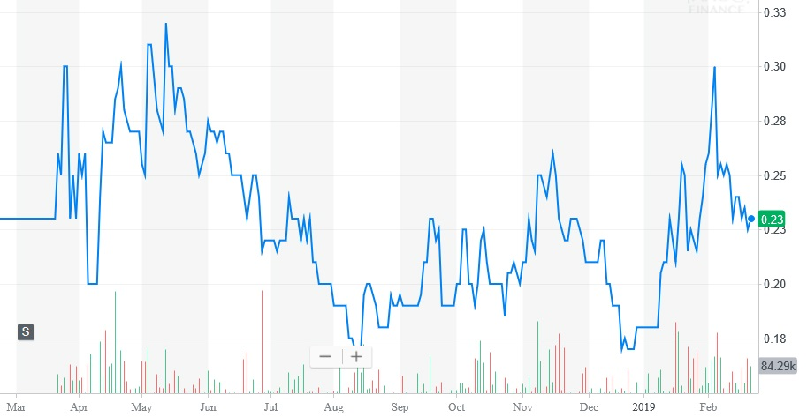
CAPITAL STRUCTURE
Capitalization & Balance Sheet | Shares
Shares Outstanding | 41,005,572
Options Outstanding & Warrants | 9,134,357
Fully Diluted Shares | 50,139,929
Fully Diluted Market Cap. @C$0.25 | $12.7 million
GPLY 12 month price graph
Ownership % Fully Diluted as of Feb 1st, 2019
Management & Insiders | 22.0%
Sandstorm Gold Ltd. (TSX: SAND) | 6.0%
JDS Energy & Mining Inc. | 4.5%
SSR Mining Inc. (TSX: SSRM) | 2.5%
Retail & Others | 64.2%
TSX-V Listed
GPLY
March 2018
Key Strategic Investors
Sandstorm Gold Ltd.
JDS Energy & Mining Inc.
SSR Mining Inc.

Slide 6

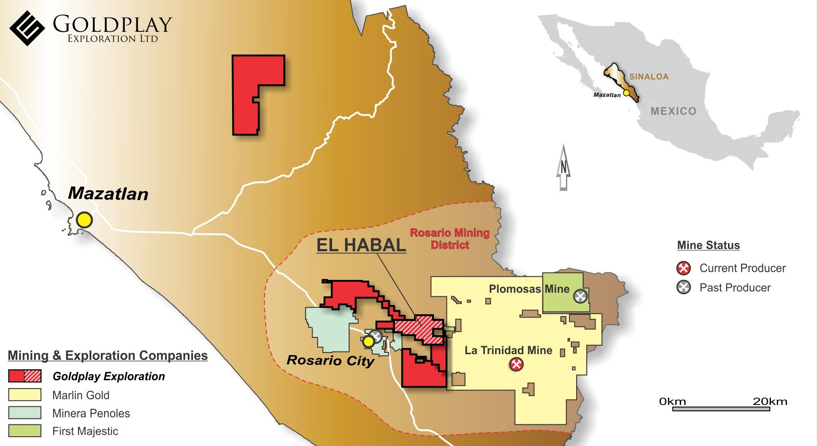
ATTRACTIVE 250 Sq. Km PORTFOLIO IN THE ROSARIO Au Ag MINING DISTRICT
SAN MARCIAL PROJECT
RESOURCE EXPANSION
High-Grade Ag Open
Pit Target
STRATEGIC PORTFOLIO IN MULTI-MILLION OUNCE HISTORICAL MINING DISTRICT
FIRST MAJESTIC
FRESNILLO

Slide 7
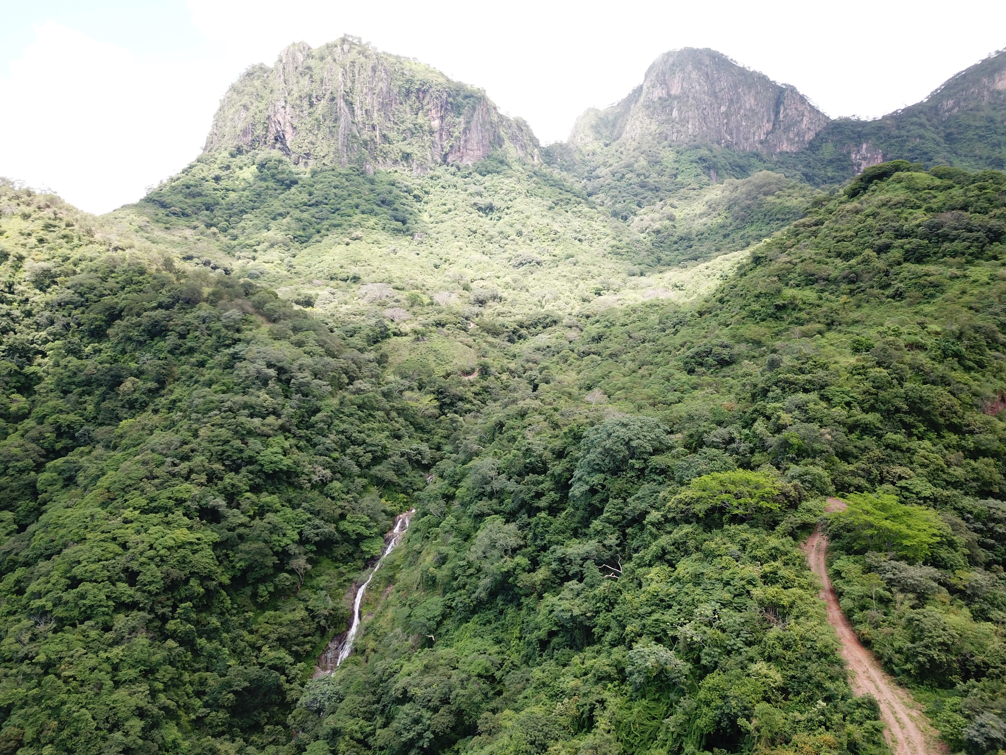
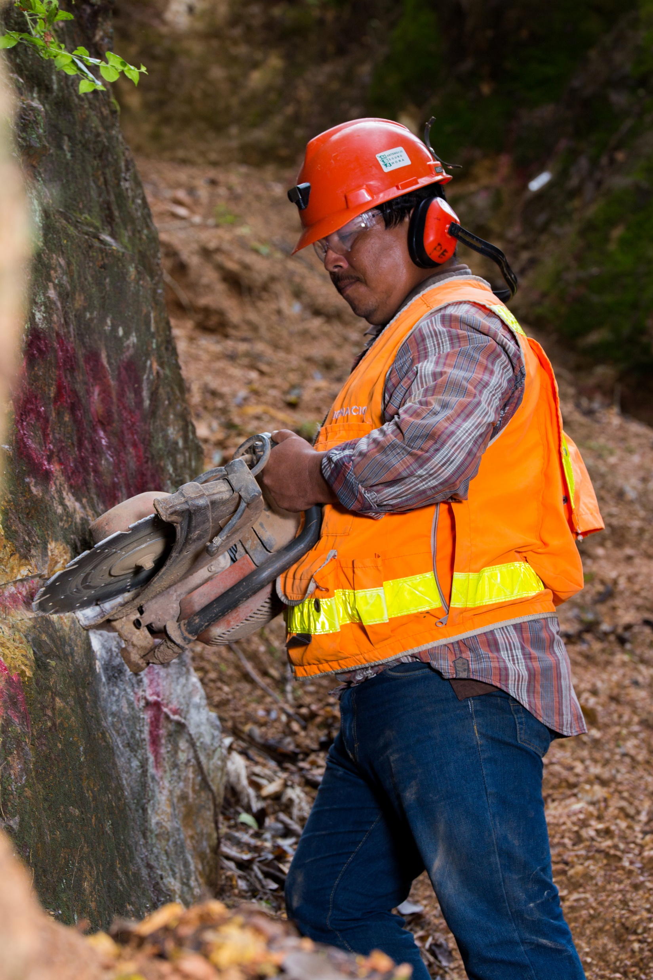
THE SAN MARCIAL PROJECT

Slide 8
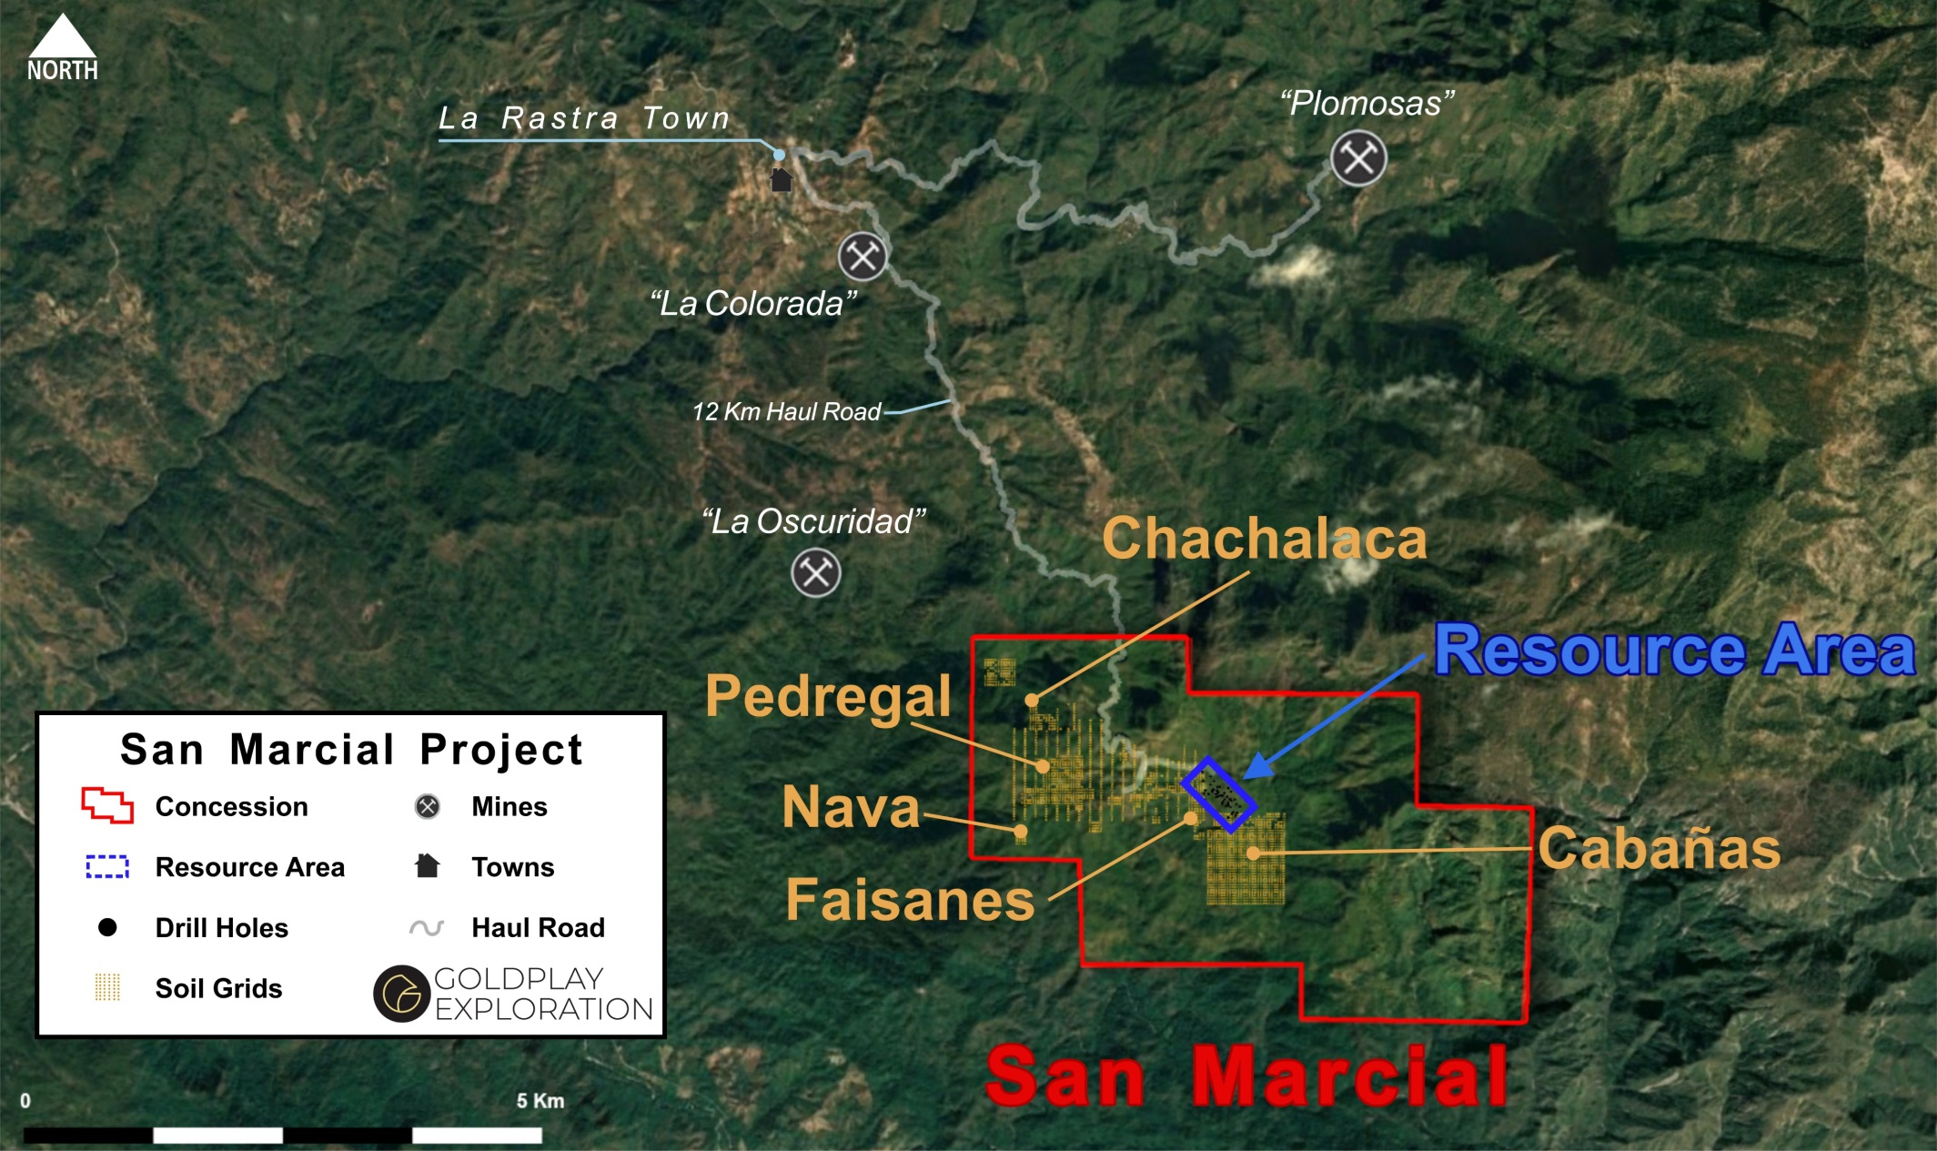
SAN MARCIAL: HIGH-GRADE Ag OPEN PIT TARGET NEAR PLOMOSAS MINE
San Marcial Project infrastructure includes:
Camp, power line, access roads, proximity to historical silver mines

Slide 9
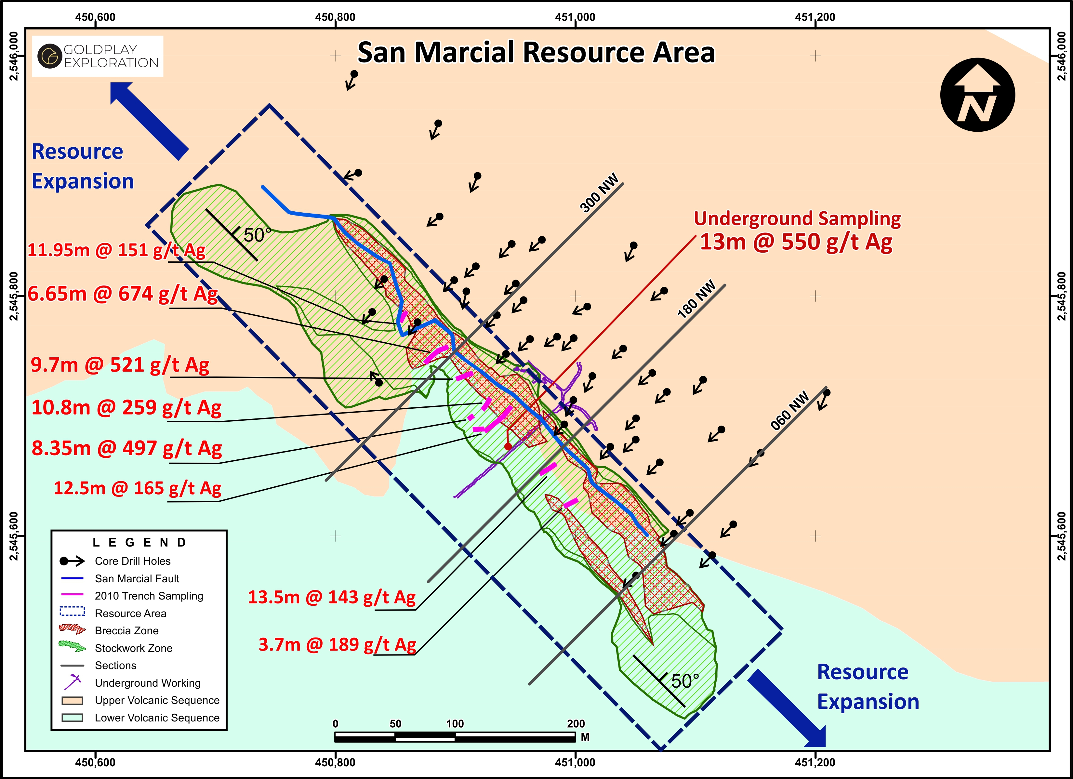
SAN MARCIAL - RESOURCE STAGE ASSET WITH GROWTH POTENTIAL
Project acquisition May 2018
Maiden Resource Feb 2019
Breccia hosted mineralization
Excellent width and grade
500 m strike length
Open along strike and at depth
Wide, high grade trench results at surface, include:
  9.7 m @ 521 g/t Ag
  8.35 m @ 497 g/t Ag

Slide 10
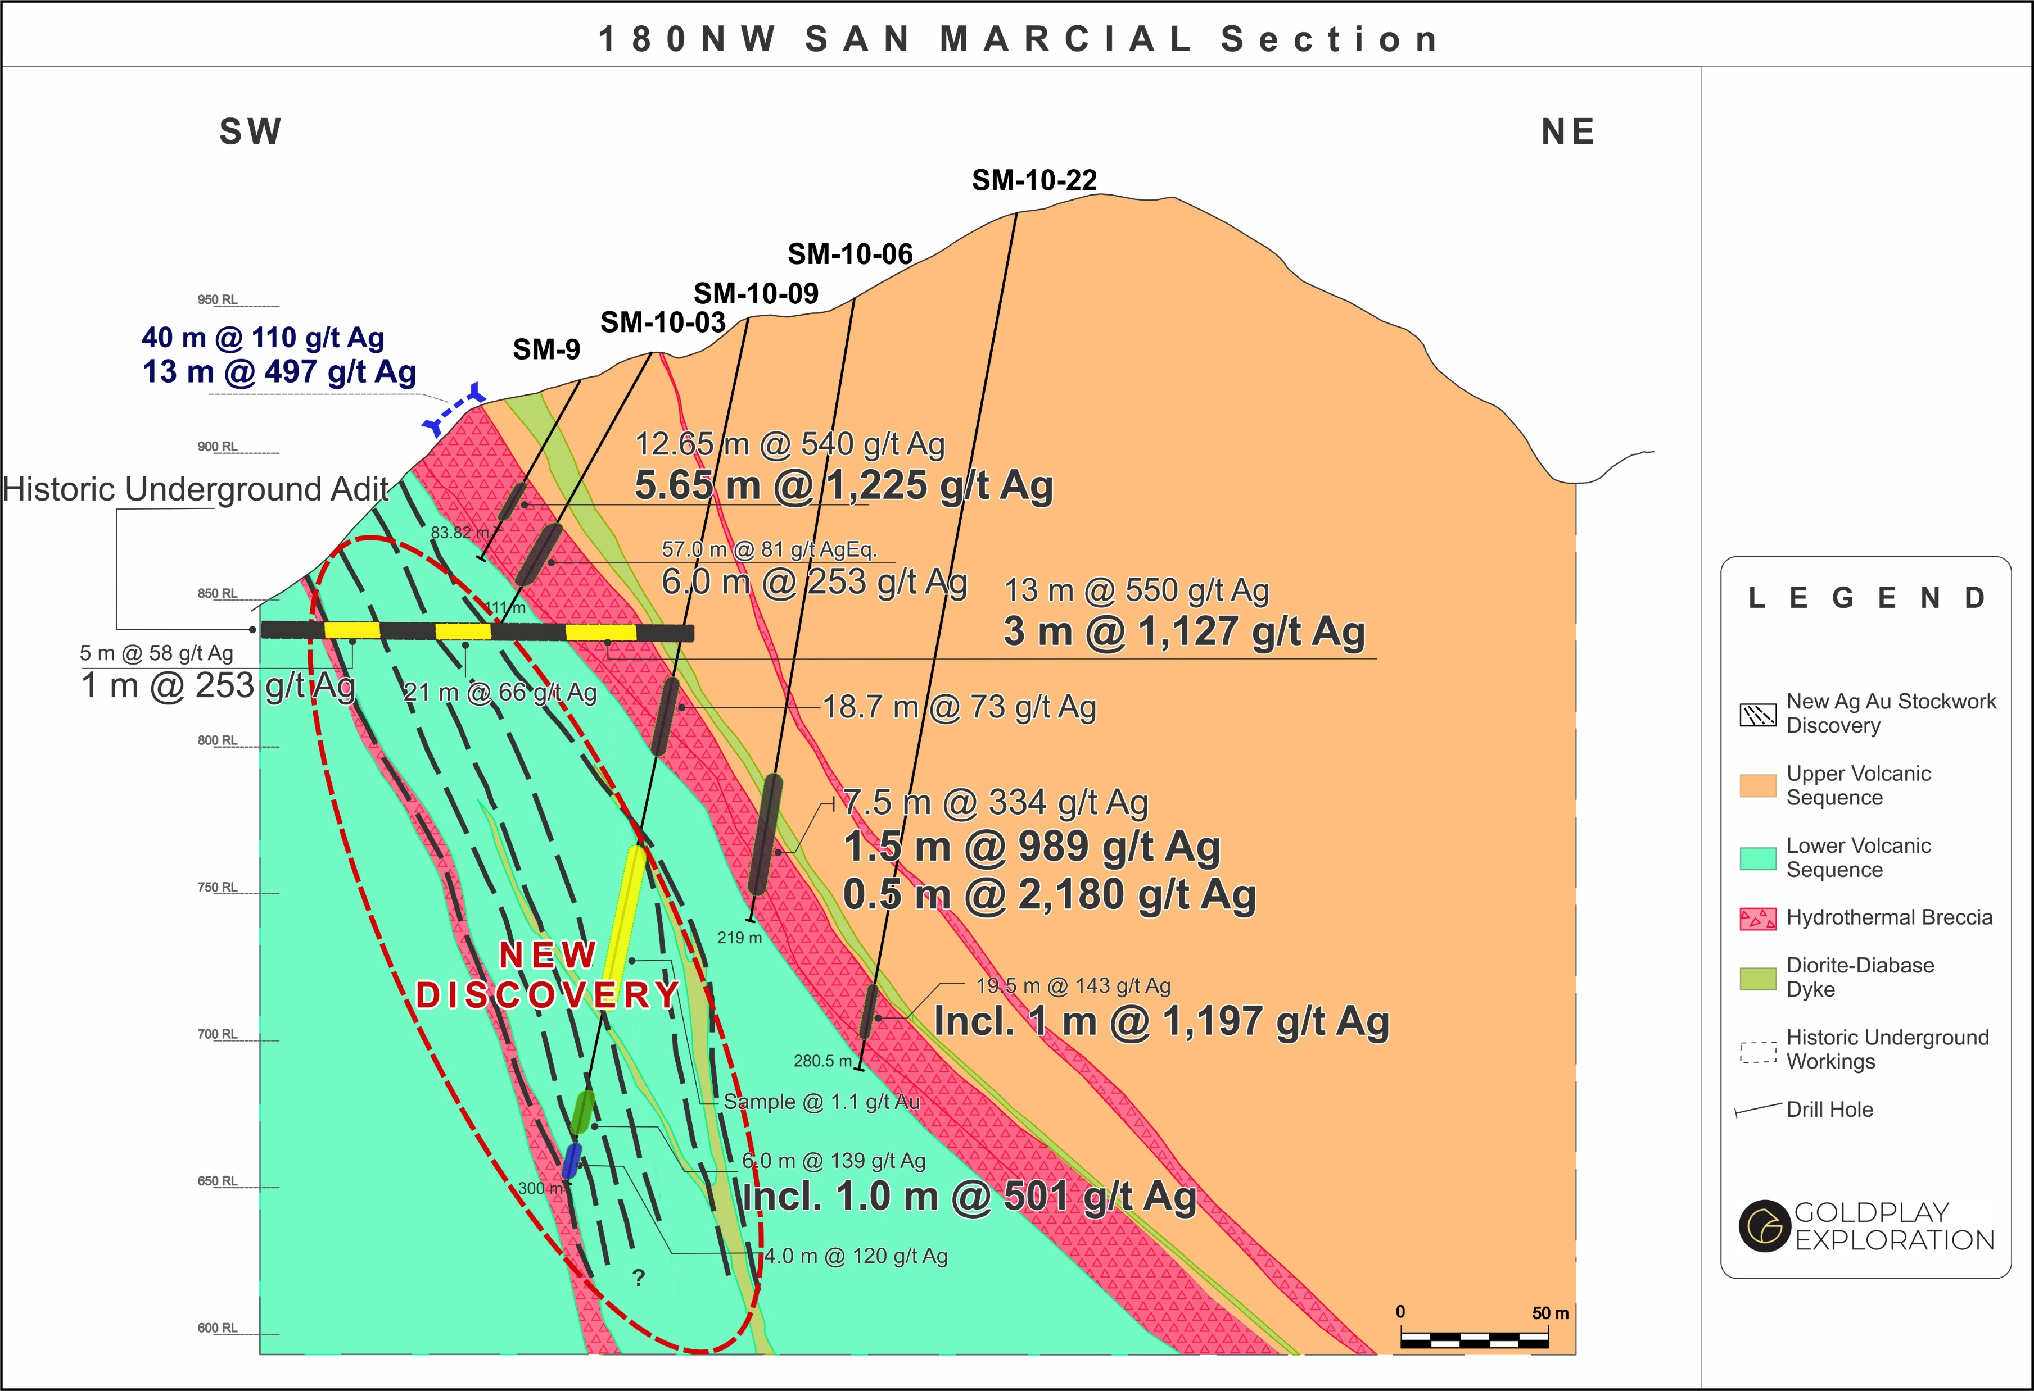
SAN MARCIAL – SECTION 180NW

Slide 11
SAN MARCIAL - NI 43-101 INDICATED + INFERRED RESOURCE SUMMARY
Indicated Resource = 36 million ounces AgEq
+
Inferred Resource = 11 million ounces AgEq
Resource Classification | Type | Tonnage (Mtonnes) | Ag (g/t) | AgEq (g/t) | Zn (%) | Pb (%) | Ag (Moz) | AgEq (Moz) | Zn (Mlbs) | Pb (Mlbs)
Indicated | Breccia (Total) | 3.0 | 200 | 239 | 0.7 | 0.4 | 19 | 23 | 43 | 29
 | Stockwork (Total) | 4.6 | 64 | 89 | 0.4 | 0.2 | 10 | 13 | 43 | 24
 | TOTAL | 7.6 | 117 | 147 | 0.5 | 0.3 | 29 | 36 | 86 | 53
Inferred | Breccia (Total) | 1.43 | 133 | 158 | 0.6 | 0.1 | 6 | 7 | 20 | 3
 | Stockwork (Total) | 1.96 | 60 | 71 | 0.2 | 0.1 | 4 | 4 | 7 | 4
 | TOTAL | 3.39 | 91 | 108 | 0.4 | 0.1 | 10 | 11 | 26 | 8
Includes open pit and underground resources. See breakdown in appendices for details

Slide 12
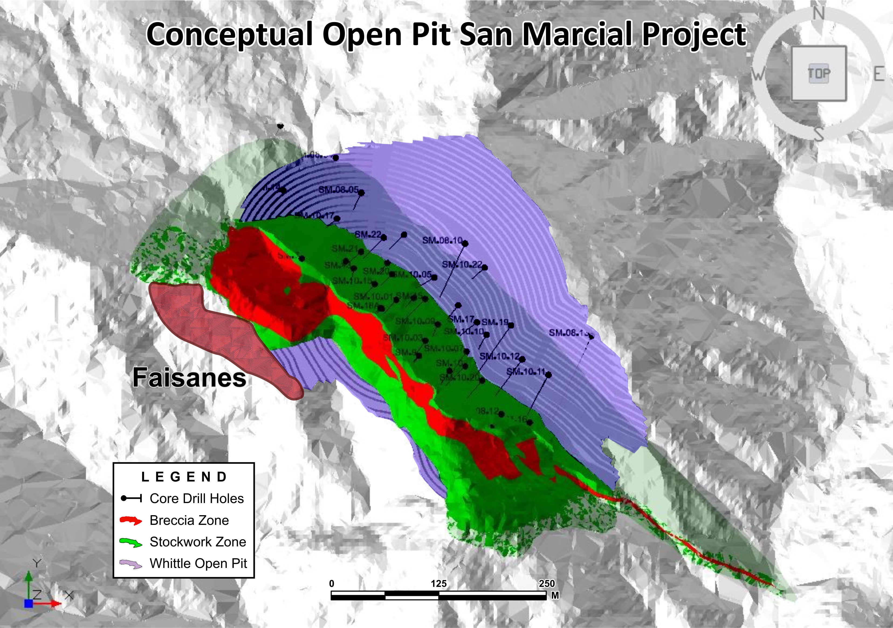

POTENTIAL FOR OPEN PIT DEVELOPMENT – HIGH GRADE Ag START-UP OPEN PIT
High-grade start-up pit
Low strip ratio
Attractive economics
Low cash cost (US$/oz Ag)
High value in situ (US$/t ore)
Resource
Expansion
Target
Breccia
Zone
Resource
Expansion
Faisanes
Target

Slide 13
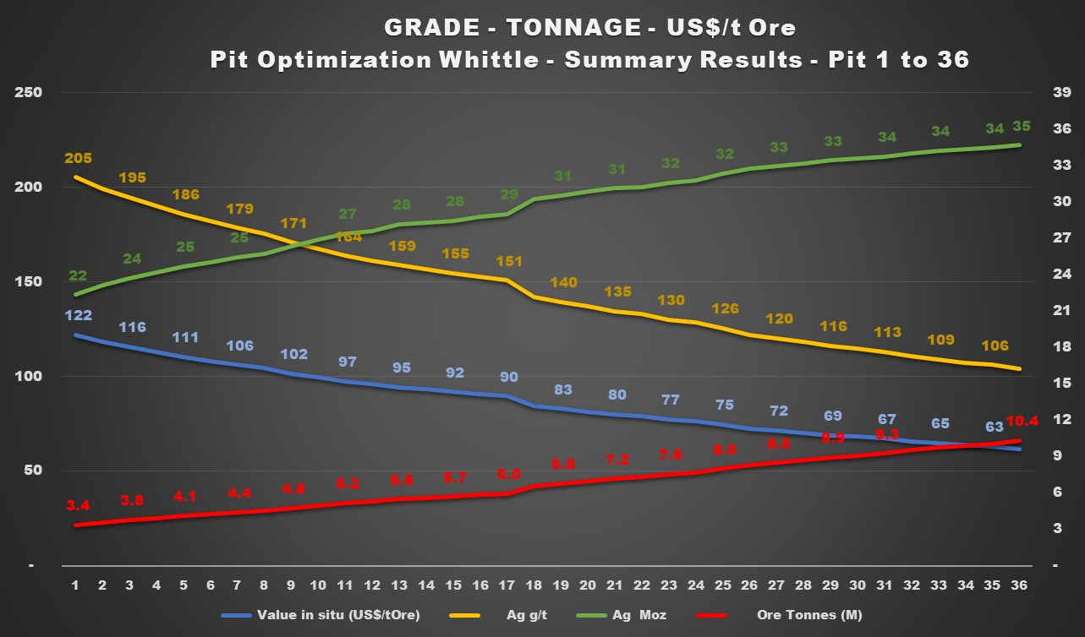
ATTRACTIVE PRELIMINARY OPEN PIT ANALYSIS – WHITTLE SIMULATION 3000 TPD
A= Pit Analysis @ U$16.28/oz Ag
B= Pit Analysis @U$8.51/oz Ag
B
A

Slide 14
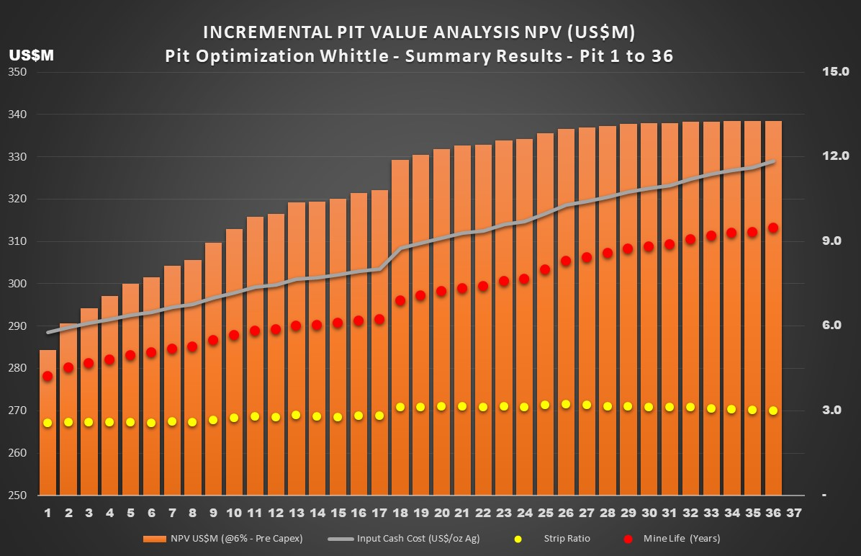
ATTRACTIVE PRELIMINARY OPEN PIT ANALYSIS (2) WHITTLE SIMULATION 3000 TPD
Potential high-grade start-up pit
Low strip ratio
Attractive preliminary assessment
Potential for low cash cost project
(US$/oz Ag)
Potential high value in situ
(US$/t ore)
A= Pit Analysis @ U$16.28/oz Ag
B= Pit Analysis @U$8.51/oz Ag
A
B

Slide 15
INVESTMENT OPPORTUNITY – ATTRACTIVE VALUATION
SilverTip UG Project
Coeur D'Alene-$325M
Construction & Operations
107Moz AgEq
Terranera UG Project
EL Compas UG Project
Resource Stage
Silver Crest Metals
Market Cap $277M
62Moz AgEq
Feasibility Study
Endeavour-NPV$101M
44Moz AgEq
Las Chispas UG Project
San Marcial OP Project
Resource Stage
SilverCorp-$15M
107Moz AgEq
CAD$M
PEA
JDS Silver-$21M
Resource Expansion
Development Stage
PEA
Endeavour $10M
15Moz AgEq
Resource Stage
Market Cap $12.7M
Endeavour-$3.6M
No Resource
Silver Crest Metals $4.3M
No Resource
PEA
Canarc $1.5M
15Moz AgEq
Drilling Stage
Goldplay-Acquisition Cost $2.5M
30Moz AgEq
Market Cap $7.2M
15
YEAR

Slide 16
SAN MARCIAL PROJECT – NEW TARGETS

Slide 17
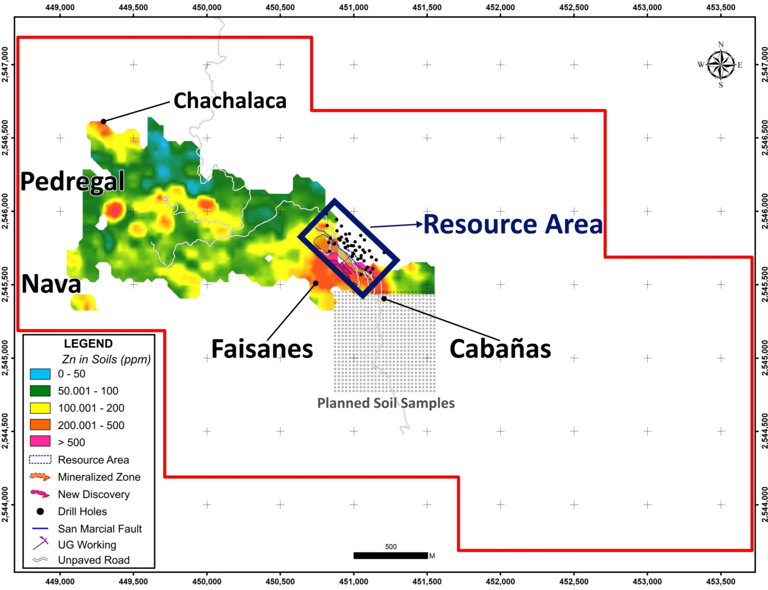

POTENTIAL FOR RESOURCE EXPANSION – SAN MARCIAL PROJECT
Exploration continues to identify new targets along the 3.5 km mineralized trend
5 new exploration targets in the vicinity of the Resource Area
Targets contiguous to resource area
Potential discoveries: Ag-Au-Zn-Pb
New Faisanes trench results extend silver mineralization to NW

Slide 18
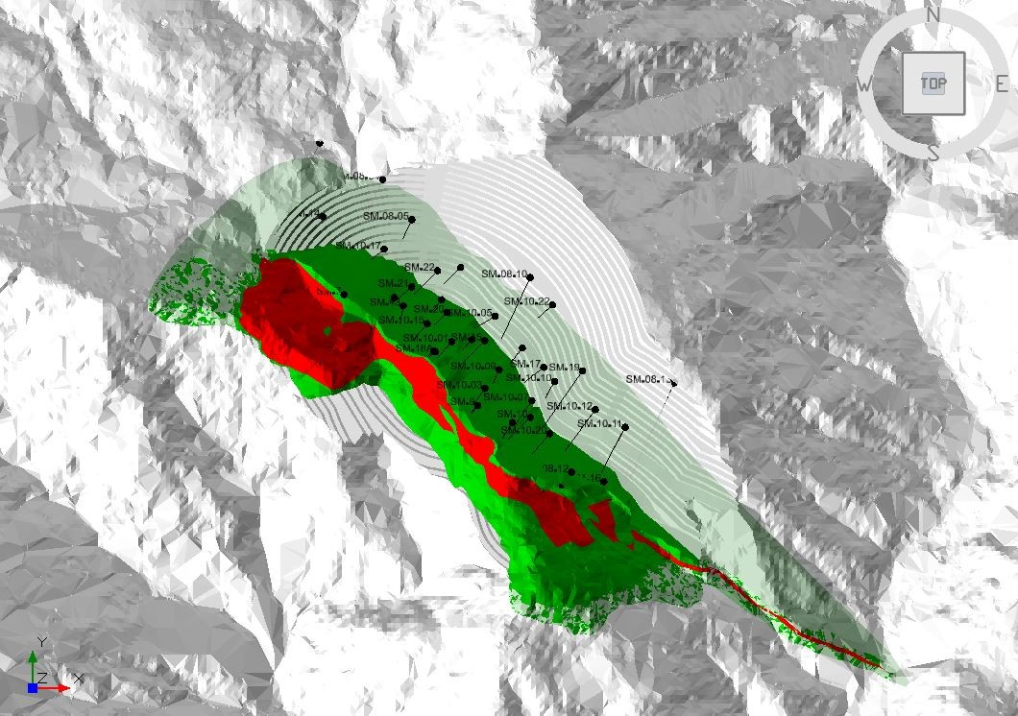

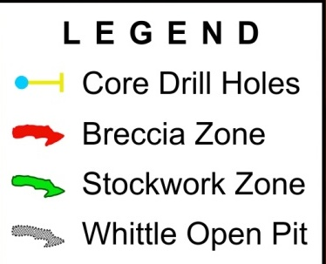
POTENTIAL FOR OPEN PIT DEVELOPMENT – FAISANES HIGH GRADE Ag NEW DISCOVERY
New high-grade discovery outside
maiden resource NI-43.101 (Feb 2019)
56m @ 196g/t Ag
Upside potential for resource expansion
Drill permits in place
Resource
Expansion
Faisanes
Target
Channel Sampling
56m @ 196g/t Ag
Breccia
Zone
Resource
Expansion
Faisanes
Target
0 m
250 m
Widths are true thickness
See News Release date 20 February 2019

Slide 19
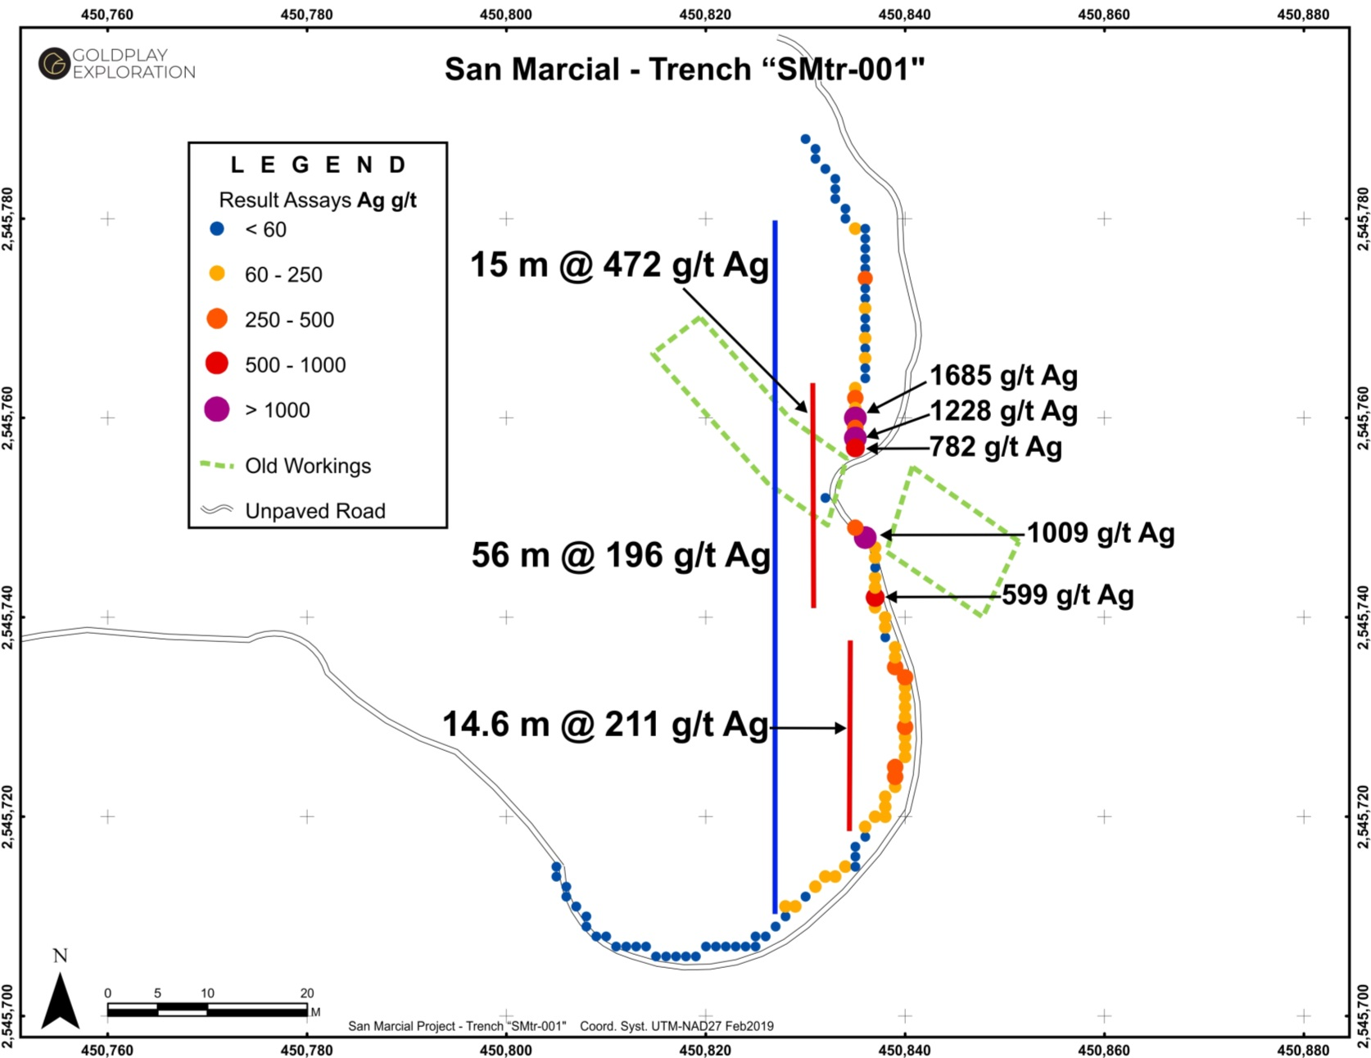
FAISANES TARGET – HIGH GRADE SILVER RESULTS IN TRENCH
Faisanes target adjacent to San Marcial silver resource
Channel samples with up to
1228 g/t Ag
Discovery of new subparallel mineralized zones
Wide silver zone of 56 m at 196 g/t Ag
  includes 15 m at 472 g/t Ag
  and 14.6 m at 211 g/t Ag
Exploration continues to identify new targets along the 3.5 km mineralized trend
Opportunity to expand resource and open pit
Widths are true thickness
See News Release date 20 February 2019

Slide 20
2019 CATALYSTS AND OBJECTIVES
Maiden NI 43-101 Resource at San Marcial – February 2019
Metallurgical Testing Program in Progress at San Marcial
Continuing exploration at San Marcial and the 3.5 km Mineralized Trend
CONFIRMED 5 NEW EXPLORATION TARGETS IN LATE 2018
Q1
San Marcial Resource Expansion - DRILL PERMITS RECEIVED
New Acquisition in Rosario Mining District
Exploration, Drilling & Discoveries
2019
Exploration & Discoveries
RESOURCE EXPANSION
12 to 18 months

Slide 21
POTENTIAL VALUE GROWTH WITH PROJECT ADVANCEMENT
EV/Ag oz: US$0.20/oz
San Marcial Resource Expansion & New Discoveries 2019
Average Ev/Ag oz Silver Developers
US$1.18/oz (1)
Average Ev/Ag oz Silver Producers
US$1.52/oz (1)
FS
US$100M
INCREASE MARKET VALUE
PFS
PEA
MAIDEN RESOURCE FEBRUARY 2019
CAD$12.5M
VALUE GROWTH – PROJECT ADVANCEMENT
Source ; Company Data

Slide 22
ROADMAP FOR GROWTH AND VALUE CREATION
  High Margin Resource & Attractive Low Cost Asset
  Drilling Targets Outlined Near Resource Area = Discoveries
  Focus on High Quality Assets
    Strategy: Add Low Cost & High Margin Ounces
  = Value Recognition
TSX-V: GPLY OTCQB: GLYXF

Slide 23



info@goldplayexploration.com
goldplayexploration.com
goldplay_gply
goldplayexploration
TSX-V: GPLY FRANKFURT: GPE OTCQB: GLYXF

Slide 24
APPENDICES

Slide 25
SAN MARCIAL - NI 43-101 INDICATED + INFERRED RESOURCE TABLE
AgEq is based on long term silver, zinc and lead prices of US$18.50 per ounce silver, US$1.10 per pound zinc and US$0.95 per pound lead. The following average metallurgical recoveries are assumed as 85% silver, 85% zinc and 95% lead. A 30 gpt AgEq cut off for open pit and 80gpt AgEq for underground resource classification completed by WSP Canada Inc. on February 06, 2019. OP is amenable for potential open pit development, UG is amenable for potential underground development.

Slide 26
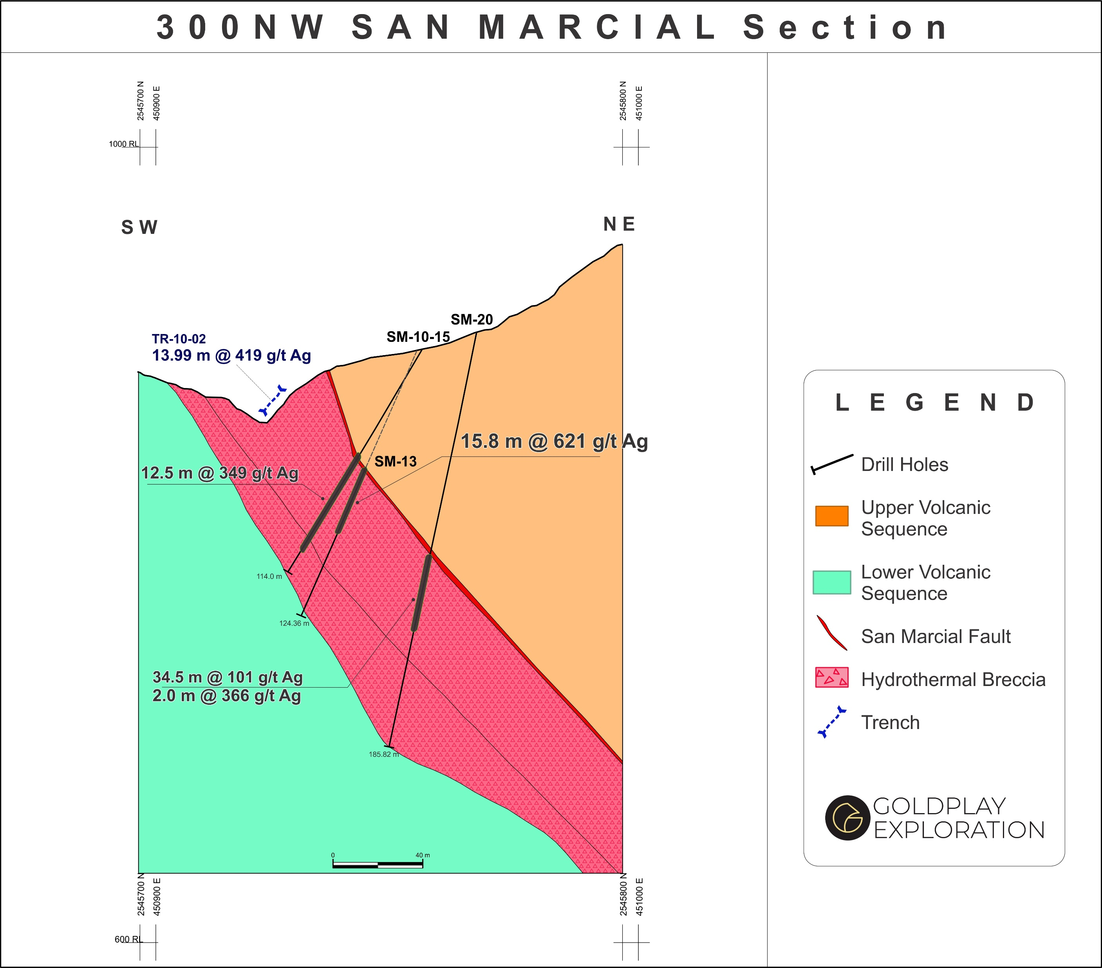
SAN MARCIAL – SECTION 300NW

Slide 27
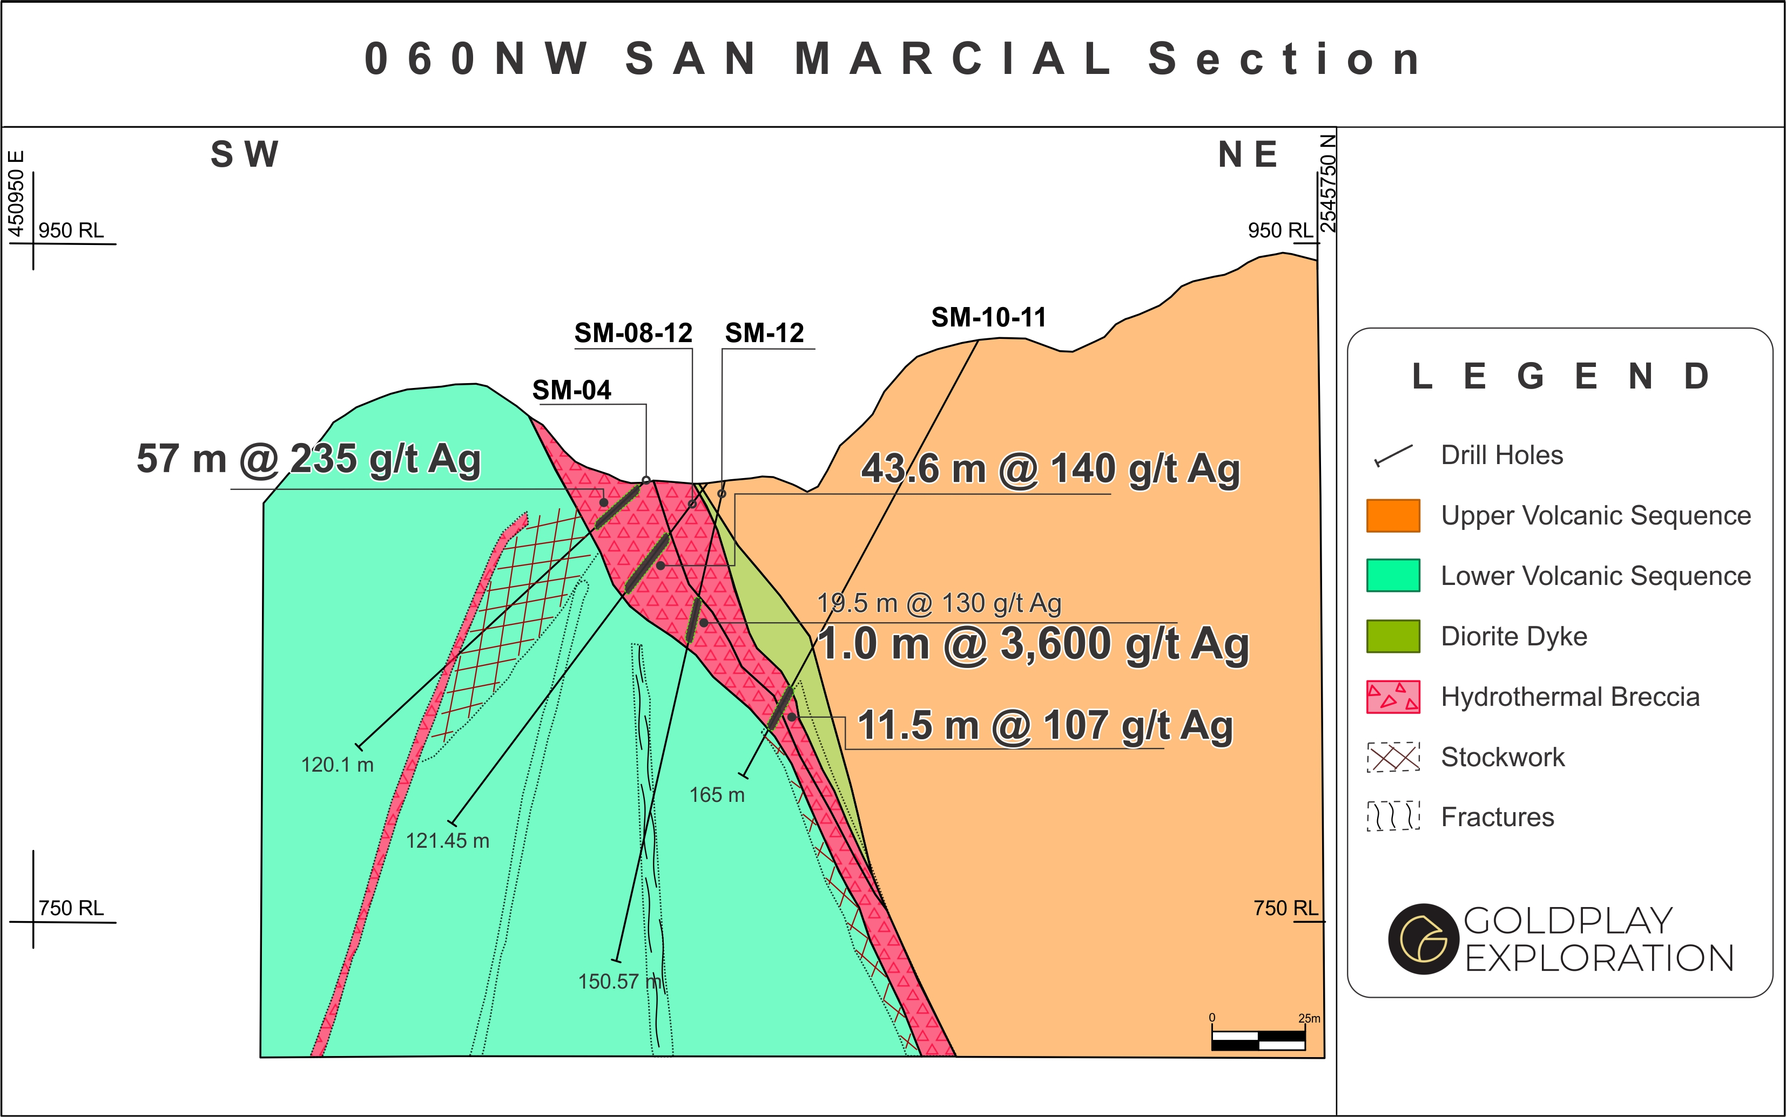
SAN MARCIAL - HIGH GRADE AT SURFACE WITH OPEN PIT GROWTH POTENTIAL
060NW San Marcial Section

